Slide 1


Edmund Lee
2023.10.26

Slide 2

Outline
Executive Summary
Introduction
Methodology
Results
Conclusion
Appendix

Slide 3
Executive Summary
Summary of methodologies
Data collection with SpaceX API
Data collection with web scrapping
Data wrangling
Exploratory data analysis with SQL
Exploratory data analysis with data visualization
Interactive visual analytics with Folium
Machine learning prediction
Summary of all results
Exploratory data analysis
Interactive analytics visualization
Predictive analysis

Slide 4
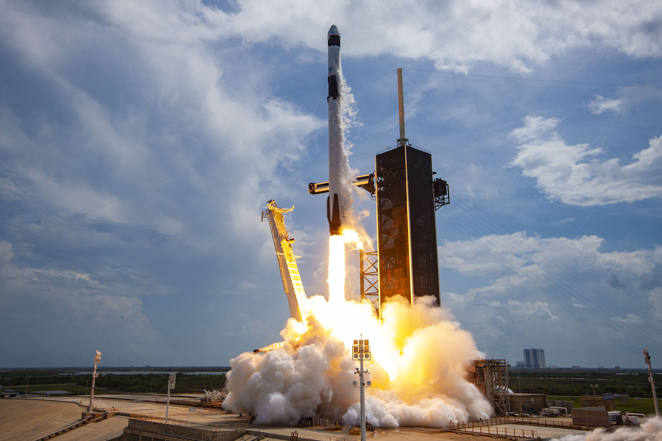
Introduction
Project Background
Space X claimed that the Falcon 9 rocket launches cost 62 million dollars whereas other provides cost 165 million dollars each launch. This significant different is due to the reusable technology by Space X that land back Falcon 9 at first stage. Hence, this study aim to build a predictive model on the success of a rocket landing.
Research Questions:
What factors influence the landing of the rocket?
What are the features for the model?
What is the success rate of landing?
Source: Popular Mechanics

Slide 5

Section 1

Slide 6
Methodology
Executive Summary
Data collection methodology:
Collect data from Space X’s API and web scrapping from Wikipedia.
Perform data wrangling
Apply one-hot encoding method upon categorical features
Perform exploratory data analysis (EDA) using visualization and SQL
Perform interactive visual analytics using Folium and Plotly Dash
Perform predictive analysis using classification models
Apply several models – SVM, decision trees, KNN, logistics regression
Compare the accuracy results

Slide 7
Data Collection
Data collection with Space X’s API
Set up the GET request to the API URL
Decode the response and turn it into Pandas data frame using .json_normalize()
Perform data wrangling, clean the missing values
Data collection with web scrapping from Wikipedia
Set up the GET request to the Wikipedia page URL
Extract all column from the HTML table header
Create a data frame by parsing the launch HTML tables
Both methods serve as a way to obtain the data of Falcon 9 launch records.

Slide 8
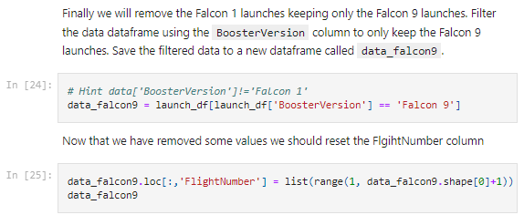
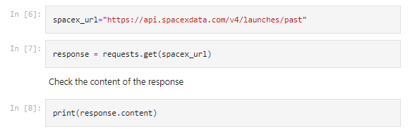
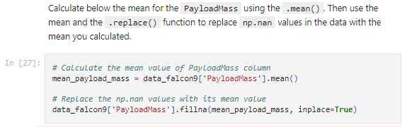
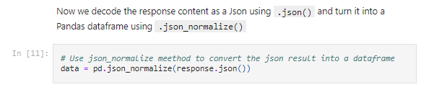
Data Collection – SpaceX API
👉🏼Link to GitHub notebook (Click HERE) 👈🏼
3. Data wrangling
1. GET request
2. Decode response content

Slide 9
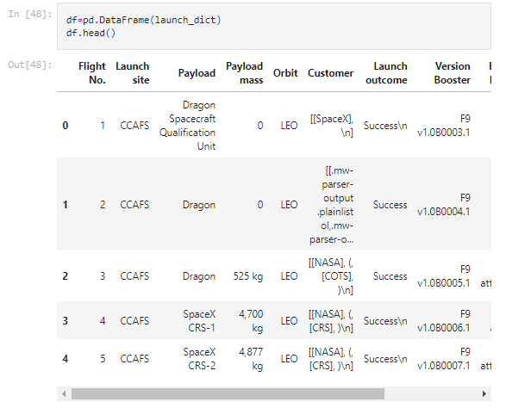
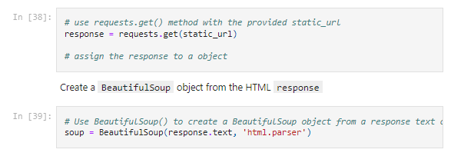
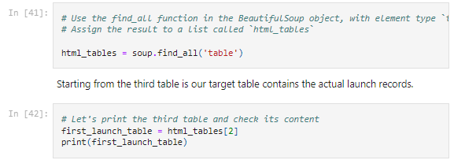
Data Collection - Scraping
👉🏼Link to GitHub notebook (Click HERE) 👈🏼
3. The final output
1. GET request
2. Extract the table

Slide 10
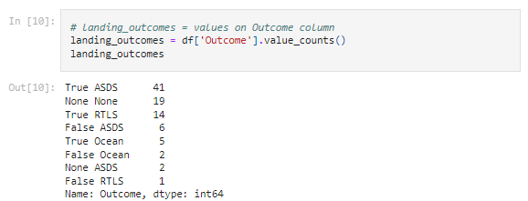
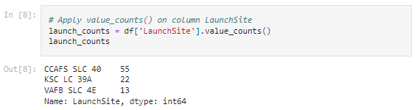
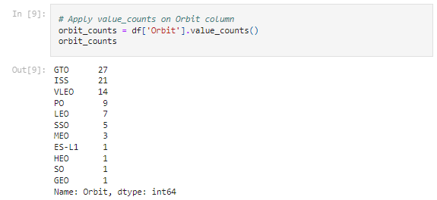
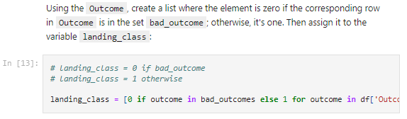
Data Wrangling
👉🏼Link to GitHub notebook (Click HERE) 👈🏼
3. Calculate the number and occurrence of mission outcome of the orbits
1. Calculate the number of launches on each sites
2. Calculate the number of occurrence of each orbit
4. Create landing outcome label (0,1)

Slide 11
EDA with Data Visualization
👉🏼Link to GitHub notebook (Click HERE) 👈🏼
Visualize the relationship between Flight Number and Launch Site
Visualize the relationship between Payload and Launch Site
Visualize the relationship between success rate of each orbit type
Visualize the relationship between Flight Number and Orbit type
Visualize the relationship between Payload and Orbit type
Visualize the launch success yearly trend

Slide 12
EDA with SQL
👉🏼Link to GitHub notebook (Click HERE) 👈🏼
Load the SQL database and perform several queries for EDA
Display the names of the unique launch sites in the space mission
Display 5 records where launch sites begin with the string 'CCA'
Display the total payload mass carried by boosters launched by NASA (CRS)
Display average payload mass carried by booster version F9 v1.1
List the date when the first succesful landing outcome in ground pad was acheived.
List the names of the boosters which have success in drone ship and have payload mass greater than 4000 but less than 6000
List the total number of successful and failure mission outcomes
…

Slide 13
Build an Interactive Map with Folium
👉🏼Link to GitHub notebook (Click HERE) 👈🏼
Mark all launch sites on a map
Mark the success/failed launches for each site on the map
Calculate the distances between a launch site to its proximities

Slide 14
Build a Dashboard with Plotly Dash
👉🏼Link to GitHub notebook (Click HERE) 👈🏼
Create a dash application (web local host application)
Add a dropdown list to enable Launch Site selection
Add a pie chart to show the total successful launches count for all sites
Add a slider to select payload range
Add a scatter chart to show the correlation between payload and launch success

Slide 15
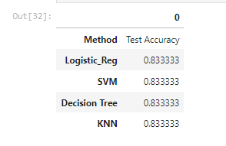
Predictive Analysis (Classification)
👉🏼Link to GitHub notebook (Click HERE) 👈🏼
Load the data
Split the data
Train and test each respective models – Logistics Regression, SVM, decision tree and KNN
Evaluate the accuracy

Slide 16
Results
Exploratory data analysis results
Interactive analytics demo in screenshots
Predictive analysis results

Slide 17

Section 2

Slide 18
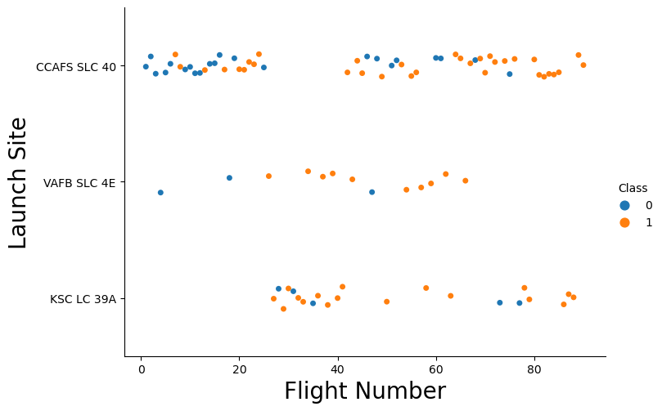
Flight Number vs. Launch Site
It shows that the larger the flight number the higher the success rate at a launch site

Slide 19
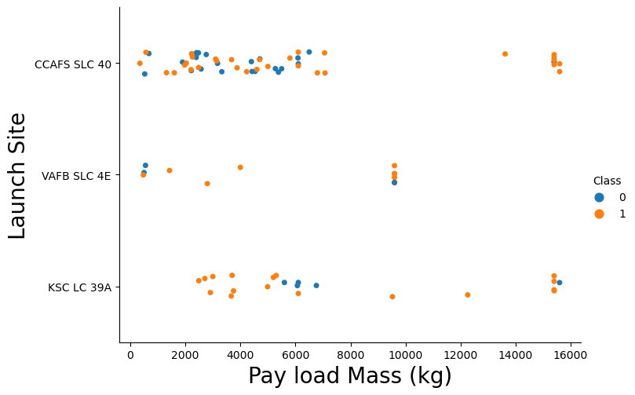
Payload vs. Launch Site
It shows that the greater the payload mass, the higher the success rate.

Slide 20
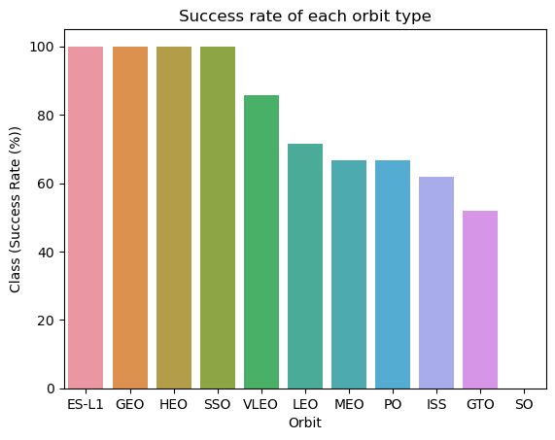
Success Rate vs. Orbit Type
It shows that ES-L1, GEO, HEO, SSO, VLEO have the highest success rate

Slide 21
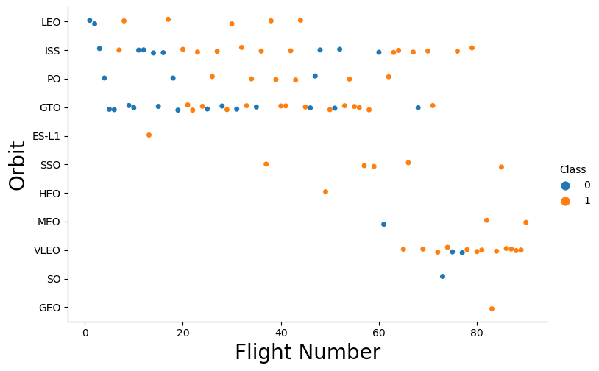
Flight Number vs. Orbit Type
It shows the higher the flight number, the higher the success rate

Slide 22
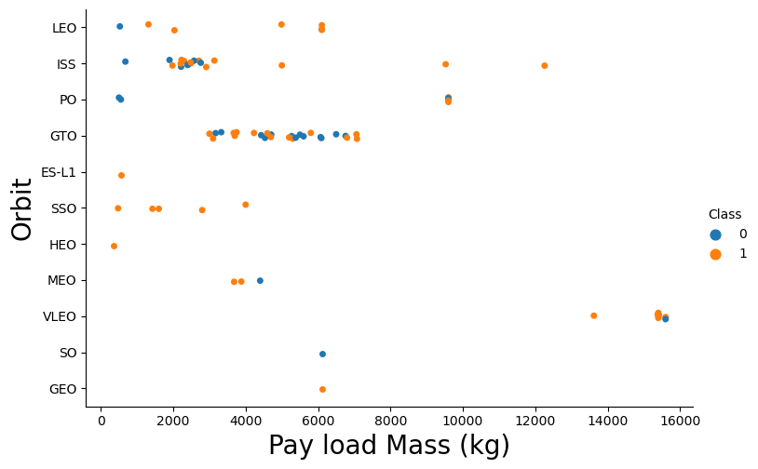
Payload vs. Orbit Type
It shows that higher payload return high success for LEO, ISS.

Slide 23
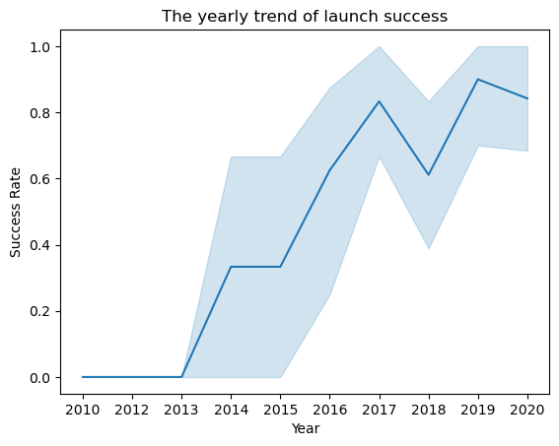
Launch Success Yearly Trend
It shows that the launch success is increasing from 2010 to 2020 generally, albeit with significant decline in 2018.

Slide 24
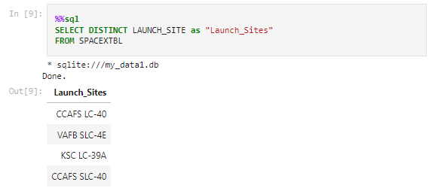
All Launch Site Names

Slide 25
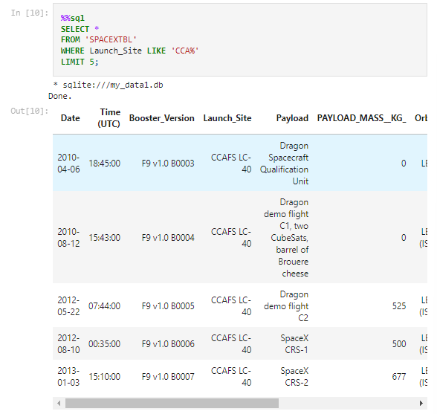
Launch Site Names Begin with 'CCA'

Slide 26
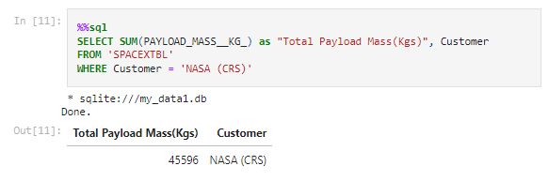
Total Payload Mass

Slide 27
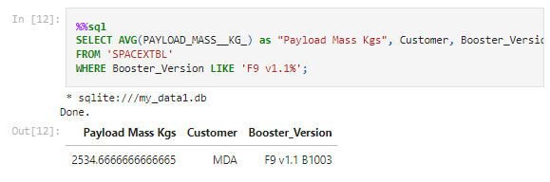
Average Payload Mass by F9 v1.1

Slide 28
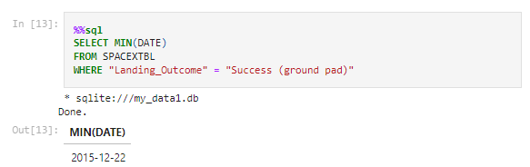
First Successful Ground Landing Date

Slide 29
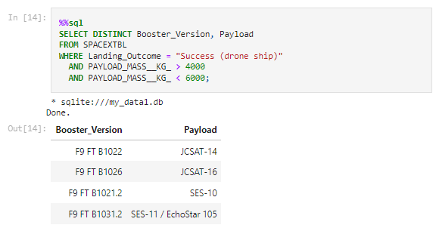
Successful Drone Ship Landing with Payload between 4000 and 6000

Slide 30
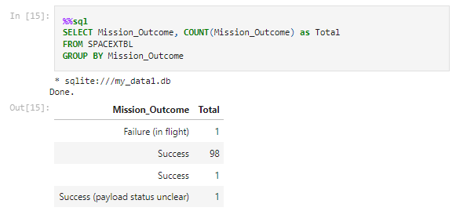
Total Number of Successful and Failure Mission Outcomes

Slide 31
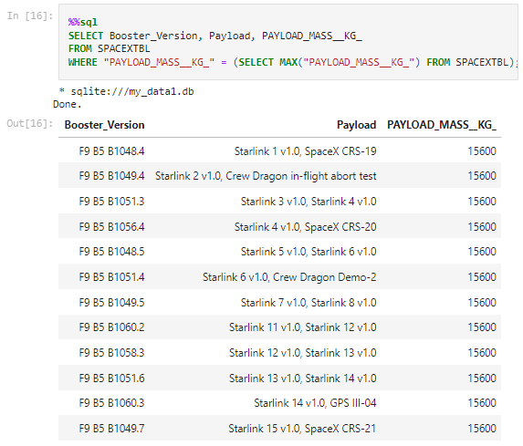
Boosters Carried Maximum Payload

Slide 32
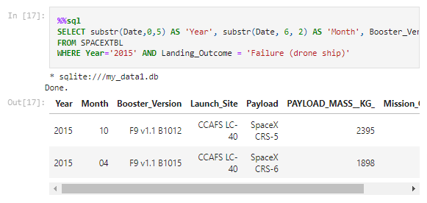
2015 Launch Records

Slide 33
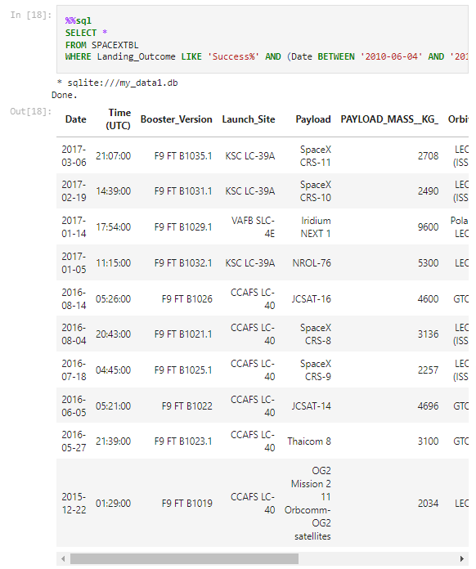
Rank Landing Outcomes Between 2010-06-04 and 2017-03-20

Slide 34

Section 3

Slide 35
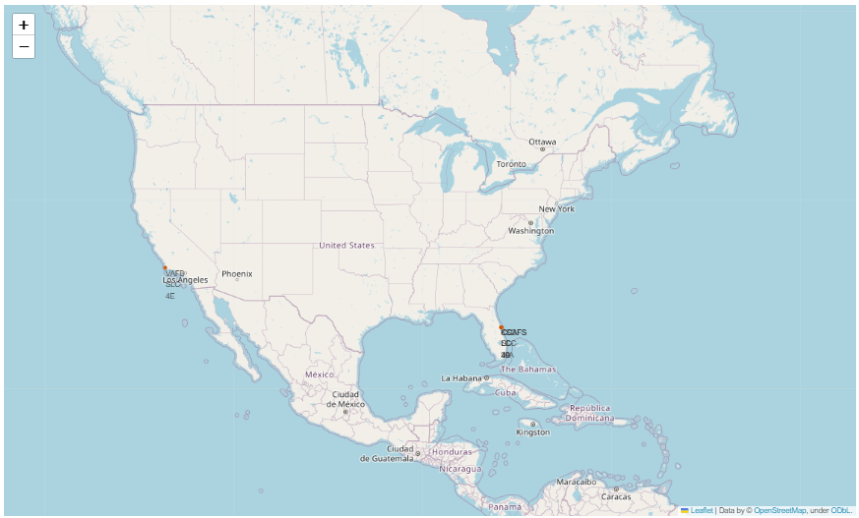
All launch sites in the United States

Slide 36
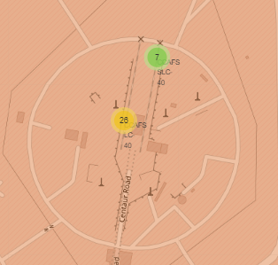
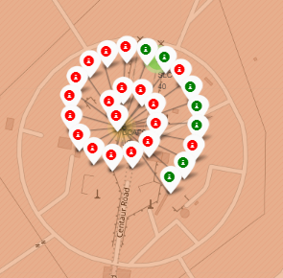
Markers showing launch sites with color labels
Green marker shows successful launches
Red marker shows failure launches

Slide 37
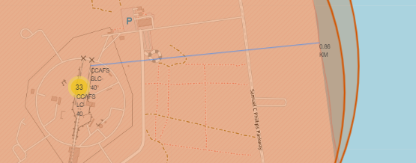
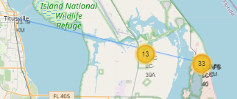
Launch Site Distance to Landmarks
0.86KM distance to coast line
23.19KM distance to city

Slide 38

Section 4

Slide 39
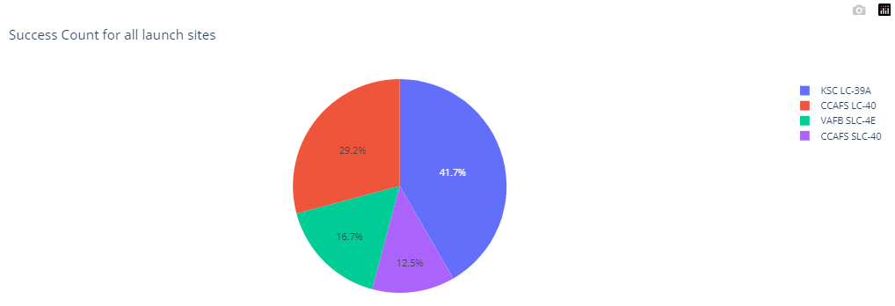
Success Count for All Launch Sites
The pie chart shows that KSC LC-39A had the highest success launch.

Slide 40
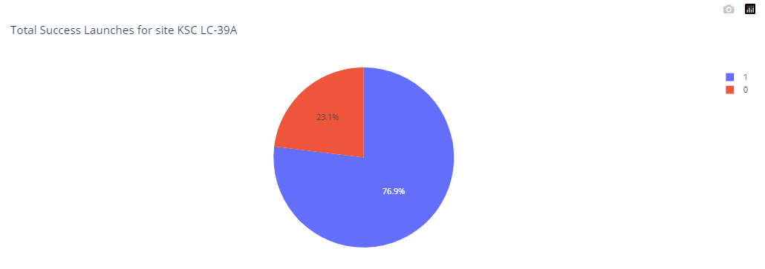
The Launch Site with the Highest Launch Success Ratio
The distribution for KSC LC-39A.

Slide 41
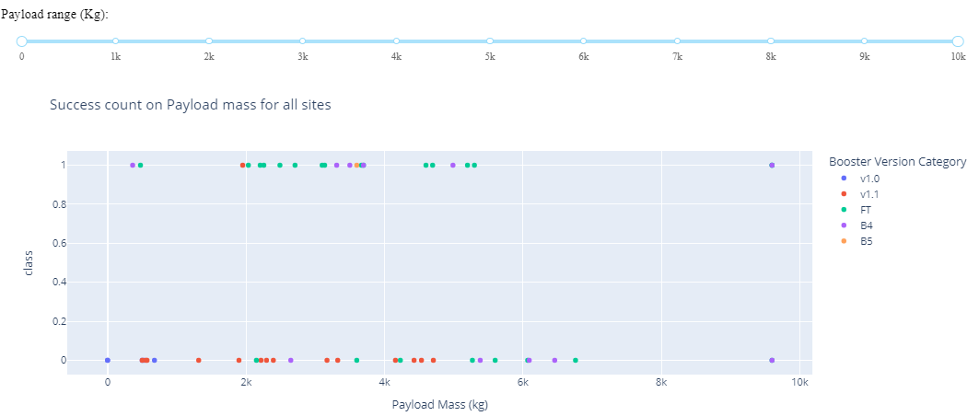
Scatter Plot of Playload mass for All Sites
Payload 0 KG to 10k KG

Slide 42
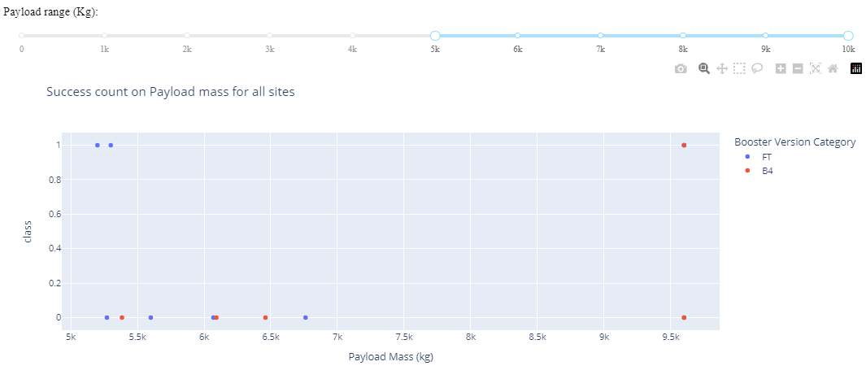
Scatter Plot of Playload mass for All Sites
Payload 5 KG to 10k KG

Slide 43

Section 5

Slide 44
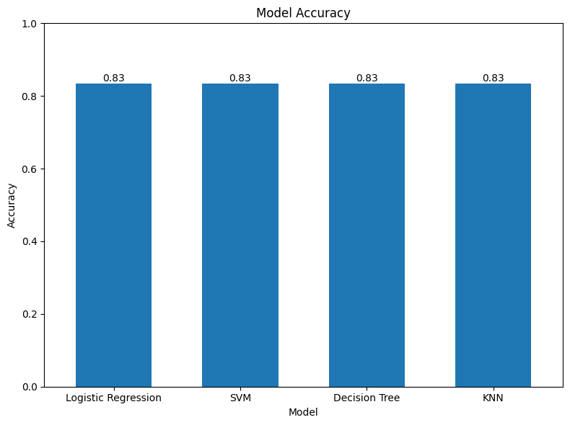
Classification Accuracy
Apparently, all four model had the same accuracy on the test dataset. Hence, they are equally good.

Slide 45

Confusion Matrix
Confusion matrix for KNN model.
The model has problem for False Positive meaning incorrectly predicting launch as landing successful but turned out it was a failure.

Slide 46
Conclusions
In conclusion, this project shows a complete machine learning predictive workflow, starts from data collection, data wrangling, exploratory data analysis, data visualization, model prediction and reporting.
The launch rate had been increasing from 2010 to 2020.
The prediction on 4 models had been the same with 83% accuracy, but the model has problem in false positive.

Slide 47
Appendix
Include any relevant assets like Python code snippets, SQL queries, charts, Notebook outputs, or data sets that you may have created during this project

Slide 48


